Slide 1
Organization and Function of ANS
S.Y.B PHARM.
Pharmacology
Presenting By-
Akash Patil

Slide 2
Contents
Introduction
What is the Autonomic Nervous System?
Types of ANS:
A. Sympathetic Nervous System
B. Parasympathetic Nervous System
Functions and Organization of the Autonomic Nervous System
Regulation and Control of the ANS
Clinical Conditions and Disorders
Conclusion
References

Slide 3
Introduction
The autonomic nervous system (ANS) is a part of the nervous system that controls the body's involuntary functions, such as heart rate, breathing, digestion, and sweating. It is divided into two main parts: the sympathetic nervous system (SNS) and the parasympathetic nervous system (PNS).
The SNS is responsible for the "fight-or-flight" response. When the SNS is activated, it causes the heart to beat faster, the blood vessels to constrict, and the pupils to dilate. This prepares the body to deal with a stressful situation.
The PNS is responsible for the "rest-and-digest" response. When the PNS is activated, it causes the heart rate to slow down, the blood vessels to dilate, and the pupils to constrict. This allows the body to relax and recover from stress.
The ANS works together with the endocrine system to maintain homeostasis, or a state of balance, in the body. When the ANS is activated, it releases hormones that have a variety of effects on the body, such as increasing heart rate, blood pressure, and blood sugar levels.
The ANS is a complex system that plays an important role in keeping the body healthy and functioning properly. When the ANS is not working properly, it can lead to a variety of health problems, such as anxiety, depression, and heart disease.

Slide 4
What is the Autonomic Nervous System?
The autonomic nervous system (ANS) is a division of the peripheral nervous system (PNS) that controls the involuntary functions of the body. It regulates and maintains the internal environment of the body, helping to ensure homeostasis, which is the body's balance and stability.
The ANS is responsible for controlling various bodily processes, such as heart rate, blood pressure, digestion, respiration, and glandular secretion. It works in conjunction with other parts of the nervous system, such as the central nervous system (CNS), which includes the brain and spinal cord.

Slide 5
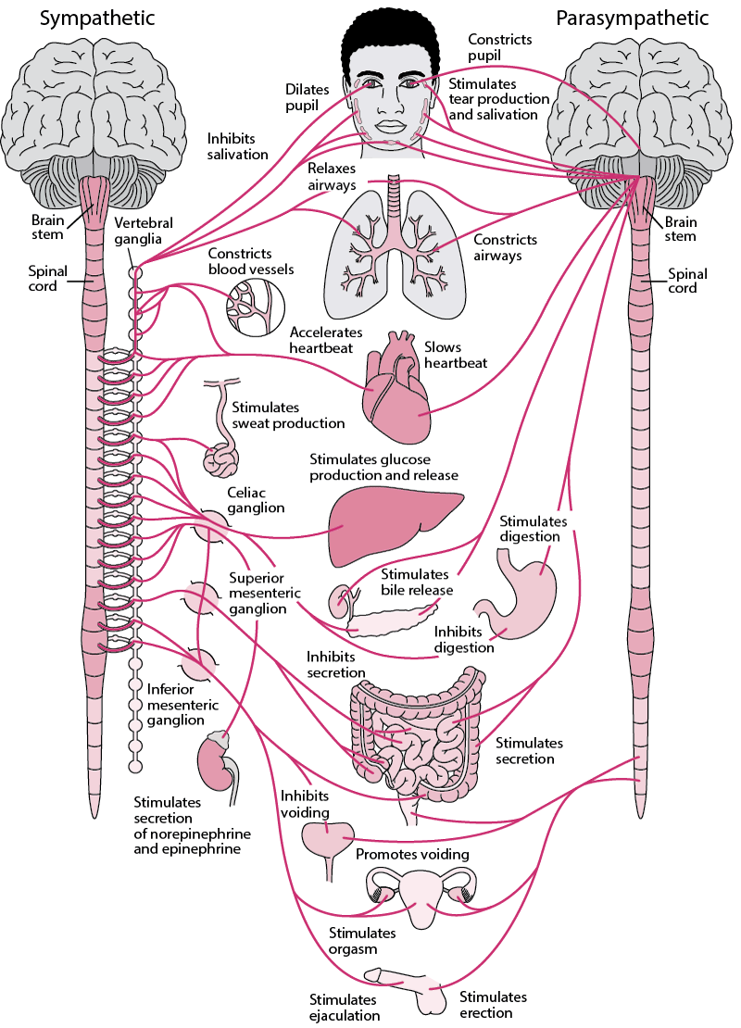
Overview of the Autonomic Nervous System

Slide 6
Types of ANS:
The autonomic nervous system consists of two main divisions: the sympathetic nervous system and the parasympathetic nervous system. These divisions have opposing effects on the body's physiological responses, providing a dynamic balance.
Sympathetic Nervous System: The sympathetic division of the ANS prepares the body for "fight-or-flight" responses. When activated, it increases heart rate, constricts blood vessels, dilates airways, stimulates the release of stress hormones like adrenaline, and mobilizes energy resources. This response is triggered in situations of stress, danger, or excitement.
Parasympathetic Nervous System: The parasympathetic division of the ANS promotes the body's "rest-and-digest" responses. It helps conserve and restore energy by slowing down heart rate, stimulating digestion, promoting relaxation, and supporting activities that occur during restful states. The parasympathetic system predominates during periods of rest and recovery.

Slide 7
Organization of the Autonomic Nervous System
The autonomic nervous system (ANS) is responsible for regulating and controlling various involuntary functions of the body. Its primary functions include:
Regulation of Heart Rate and Blood Pressure: The ANS controls the heart rate and blood pressure through the sympathetic and parasympathetic divisions. The sympathetic division increases heart rate and blood pressure, while the parasympathetic division slows them down.
Control of Respiration: The ANS regulates the rate and depth of breathing. The sympathetic division dilates the airways, increases respiratory rate, and enhances oxygen intake during stressful situations. The parasympathetic division, on the other hand, constricts the airways and slows down the respiratory rate during rest.
Gastrointestinal Function: The ANS influences various aspects of digestion, including the secretion of digestive enzymes, the movement of food through the gastrointestinal tract (peristalsis), and the release of bile. The parasympathetic division stimulates these processes, while the sympathetic division inhibits them.
Regulation of Body Temperature: The ANS helps regulate body temperature through its effects on blood vessels and sweat glands. The sympathetic division can constrict blood vessels and reduce blood flow to the skin, conserving heat in cold environments. It can also stimulate sweat gland activity to cool the body in hot conditions.

Slide 8
Continue….
Control of Urinary Function: The ANS regulates urinary function by controlling the contraction of the bladder and the relaxation of the urinary sphincters. The parasympathetic division stimulates bladder contraction and sphincter relaxation, promoting urination, while the sympathetic division has the opposite effect.
Modulation of Pupillary Size: The ANS controls the size of the pupils in the eyes. The sympathetic division dilates the pupils (mydriasis), enhancing vision in low-light conditions or during periods of alertness. The parasympathetic division constricts the pupils (miosis), reducing the amount of incoming light.
Regulation of Glandular Secretions: The ANS controls the secretion of various glands, including sweat glands, salivary glands, lacrimal glands (tear production), and digestive glands. The sympathetic and parasympathetic divisions have different effects on these secretions.
Sexual Function: The ANS plays a role in sexual arousal and function. It controls processes such as erection in males and vaginal lubrication in females. The parasympathetic division is involved in promoting sexual arousal and facilitating sexual function.

Slide 9
Regulation and Control of the ANS
Hypothalamus
Brainstem
Spinal Cord
Autonomic Ganglia
Neurotransmitters
Feedback Loops
Higher Brain Regions
Hormones

Slide 10
Clinical Conditions and Disorders
Dysautonomia: Dysautonomia refers to a group of conditions characterized by dysfunction of the autonomic nervous system. It can manifest as abnormalities in regulating blood pressure, heart rate, body temperature, digestion, and other autonomic functions.
Autonomic Neuropathy: Autonomic neuropathy occurs when the autonomic nerves that control involuntary functions are damaged. It can be caused by various underlying conditions such as diabetes, autoimmune diseases, certain infections, and certain medications.
Multiple System Atrophy (MSA): Multiple system atrophy is a rare neurodegenerative disorder that affects the autonomic nervous system, as well as other parts of the brain. It leads to progressive dysfunction in multiple systems, including the autonomic, motor, and cognitive functions.
Horner's Syndrome: Horner's syndrome occurs due to damage or disruption of the sympathetic pathway that controls the pupils, eyelids, and facial sweat glands. It is typically characterized by a combination of symptoms, including a small pupil (miosis), drooping of the eyelid (ptosis), decreased sweating on one side of the face, and a slightly sunken appearance of the affected eye.

Slide 11
Conclusion
The autonomic nervous system (ANS) is a crucial division of the peripheral nervous system that controls and regulates involuntary functions in the body. It consists of the sympathetic and parasympathetic divisions, which work in opposition to maintain balance and ensure the proper functioning of various organs and systems.
The ANS plays a vital role in regulating heart rate, blood pressure, respiration, digestion, body temperature, urinary function, glandular secretions, and many other physiological processes. It helps the body adapt to different situations, whether it's responding to stress and danger through the sympathetic "fight-or-flight" response or promoting rest and relaxation through the parasympathetic "rest-and-digest" response.
However, the ANS can be affected by clinical conditions and disorders that lead to dysregulation or dysfunction. Conditions such as dysautonomia, autonomic neuropathy, multiple system atrophy, Horner's syndrome, vasovagal syncope, and hyperhidrosis can impact autonomic function and result in various symptoms and complications.
Understanding the functions, organization, regulation, and clinical aspects of the autonomic nervous system can help healthcare professionals diagnose and manage related disorders, leading to improved patient care and quality of life.

Slide 12
References
Autonomic Nervous System. (2023, March 8). In Wikipedia, The Free Encyclopedia. Retrieved 10:41, May 28, 2023, from https://en.wikipedia.org/wiki/Autonomic_nervous_system
Anatomy, Autonomic Nervous System. (2023, May 27). In StatPearls [Internet]. Retrieved 10:42, May 28, 2023, from https://www.ncbi.nlm.nih.gov/books/NBK539845/
Physiology, Autonomic Nervous System. (2023, May 27). In StatPearls [Internet]. Retrieved 10:43, May 28, 2023, from https://www.ncbi.nlm.nih.gov/books/NBK538516/
Autonomic Nervous System: Anatomy, Physiology, and Relevance in Anaesthesia and Critical Care Medicine. (2017, November 1). In BJA Education [Internet]. Retrieved 10:44, May 28, 2023, from https://academic.oup.com/bjaed/article/16/11/381/2445840
Integrative Action of the Autonomic Nervous System. (2014). Cambridge University Press. Retrieved 10:45, May 28, 2023, from https://www.cambridge.org/core/books/integrative-action-of-the-autonomic-nervous-system/references/89520933A17BF889EEA1E3ED61F2B668

